Slide 1

Harcourt Journeys: Vocabulary Strategies
Copyright © 2011 Kelly Mott
Notes:
1

Slide 2

Unit 1: Lesson 2
Prefixes
(in-, im-, il-, ir-)
Copyright © 2011 Kelly Mott
Notes:
2

Slide 3
Prefixes (in-, im-, il-, ir-):
Part 1: PowerPoint Lesson
Part 2: Projectable 2.5
Part 3: Practice Book Page 15
stop here
Part 4: Leveled Practice 19
Leveled Practice 22
Leveled Practice 25
Copyright © 2011 Kelly Mott

Slide 4
Part 1: Introduce Strategy
Copyright © 2011 Kelly Mott
Notes:
4

Slide 5

A prefix is a word part (affix) that is added to the beginning of a root word.
Copyright © 2011 Kelly Mott

Slide 6
Today we are going to look at the prefixes:
im-
ir-
in-
il-
Copyright © 2011 Kelly Mott

Slide 7
Let’s look at the prefix:
in-
Copyright © 2011 Kelly Mott

Slide 8

The prefix in- means not.
Copyright © 2011 Kelly Mott

Slide 9
EXAMPLE WORDS
Copyright © 2011 Kelly Mott

Slide 10

insecure means?
- not secure
Copyright © 2011 Kelly Mott

Slide 11

injustice means?
- not having justice
Copyright © 2011 Kelly Mott

Slide 12
Let’s look at the prefix:
im-
Copyright © 2011 Kelly Mott

Slide 13

The prefix im- means not.
Copyright © 2011 Kelly Mott

Slide 14
EXAMPLE WORDS
Copyright © 2011 Kelly Mott

Slide 15


impolite means?
- not polite
Copyright © 2011 Kelly Mott

Slide 16

impossible means?
- not possible
Copyright © 2011 Kelly Mott

Slide 17
Let’s look at the prefix:
il-
Copyright © 2011 Kelly Mott

Slide 18
The prefix il- means not.
Copyright © 2011 Kelly Mott

Slide 19
EXAMPLE WORDS
Copyright © 2011 Kelly Mott

Slide 20

illegal means?
-not legal
Copyright © 2011 Kelly Mott

Slide 21

illogical means?
- not having logic
Copyright © 2011 Kelly Mott

Slide 22
Let’s look at the prefix:
ir-
Copyright © 2011 Kelly Mott

Slide 23
The prefix ir- means not.
Copyright © 2011 Kelly Mott

Slide 24
EXAMPLE WORDS
Copyright © 2011 Kelly Mott

Slide 25
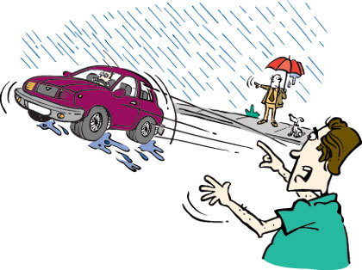
irresponsible means?
- not responsible
Copyright © 2011 Kelly Mott

Slide 26

irreplaceable means?
- not able to be replaced
Copyright © 2011 Kelly Mott

Slide 28
Part 2: Projectables
Copyright © 2011 Kelly Mott
Notes:
28

Slide 29

Projectable 2.5
Copyright © 2011 Kelly Mott

Slide 30
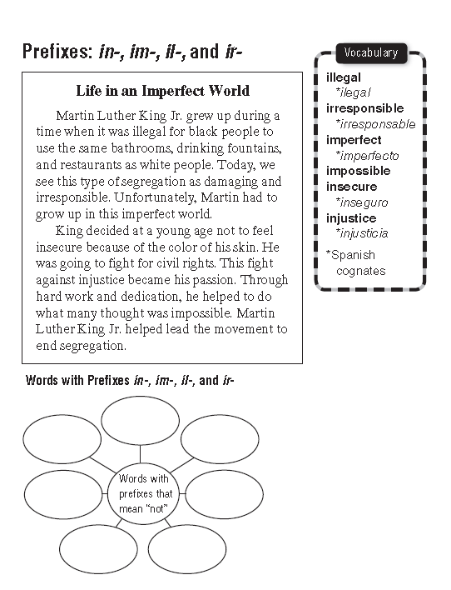
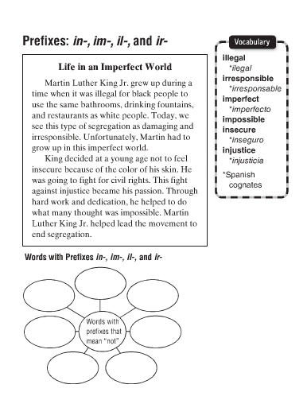

Slide 32
Part 3: Guided Practice
Copyright © 2011 Kelly Mott
Notes:
32

Slide 33
Turn your Practice Book to page 15 Fill in
With your partner.
Copyright © 2011 Kelly Mott

Slide 34
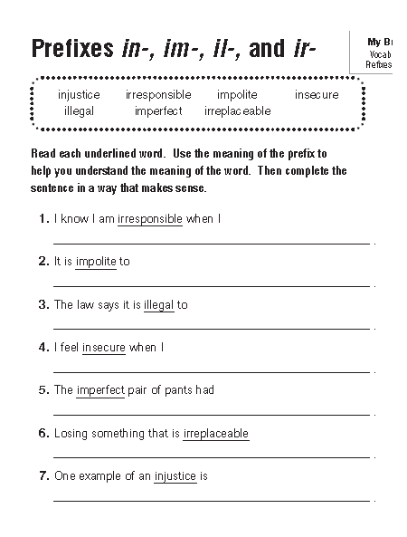

Slide 36
Part 4: Independent Practice
Copyright © 2011 Kelly Mott
Notes:
36

Slide 37
See Handout; page 19 in Grab and Go
Copyright © 2011 Kelly Mott

Slide 38
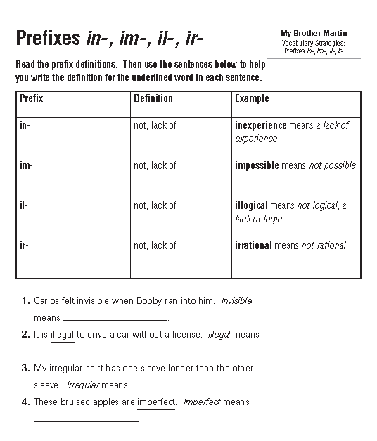

Slide 40
See Handout; page 22 in Grab and Go
Copyright © 2011 Kelly Mott

Slide 41
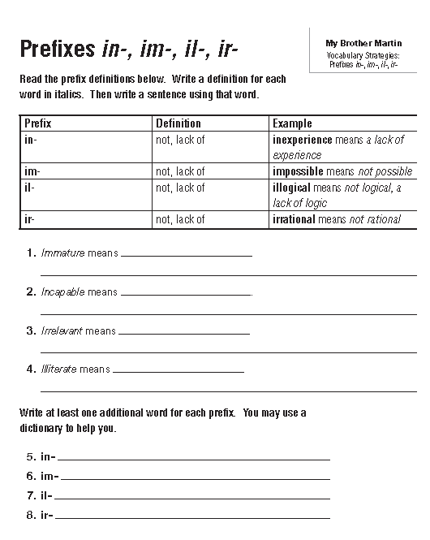

Slide 43
See Handout; page 25 in Grab and Go
Copyright © 2011 Kelly Mott

Slide 44
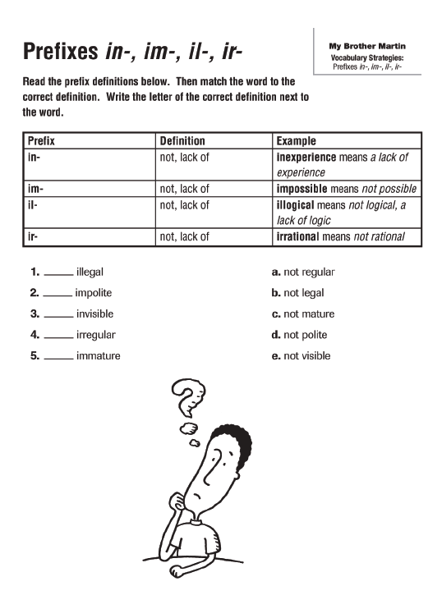

Slide 46

How did you do?
Copyright © 2011 Kelly Mott

Slide 47
Copyright © 2011 Kelly Mott

Slide 48


