Slide 1

Harcourt Journeys: Vocabulary Strategies
Copyright © 2011 Kelly Mott
Notes:
1

Slide 2

Unit 1: Lesson 1
Prefixes
(re-, un-, dis-)
Copyright © 2011 Kelly Mott
Notes:
2

Slide 3
Prefixes (re-, un-, dis-):
Part 1: PowerPoint Lesson
Part 2: Projectable 1.5
Part 3: Practice Book Page 3
Part 4: Leveled Practice 19
Leveled Practice 25
Copyright © 2011 Kelly Mott

Slide 4
Part 1: Introduce Strategy
Copyright © 2011 Kelly Mott
Notes:
4

Slide 5

A prefix is a word part (affix) that is added to the beginning of a root word.
Copyright © 2011 Kelly Mott

Slide 6
Today we are going to look at the prefixes:
un-
re-
dis-
Copyright © 2011 Kelly Mott

Slide 7
Let’s look at the prefix:
re-
Copyright © 2011 Kelly Mott

Slide 8

The prefix re- means again.
Copyright © 2011 Kelly Mott

Slide 9
EXAMPLE WORDS
Copyright © 2011 Kelly Mott

Slide 10

Redo means?
- to do again
Copyright © 2011 Kelly Mott

Slide 11
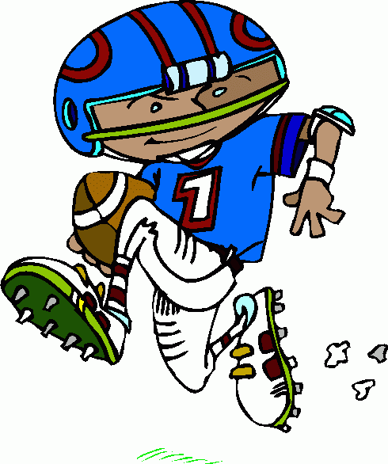
Replay means?
- to play again
Copyright © 2011 Kelly Mott

Slide 12
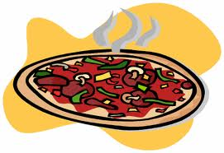
Reheat means?
- to heat again
Copyright © 2011 Kelly Mott

Slide 13
Let’s look at the prefix:
un-
Copyright © 2011 Kelly Mott

Slide 14

The prefix un- means not or the opposite of.
Copyright © 2011 Kelly Mott

Slide 15
EXAMPLE WORDS
Copyright © 2011 Kelly Mott

Slide 16

unsure means?
- not sure
Copyright © 2011 Kelly Mott

Slide 17
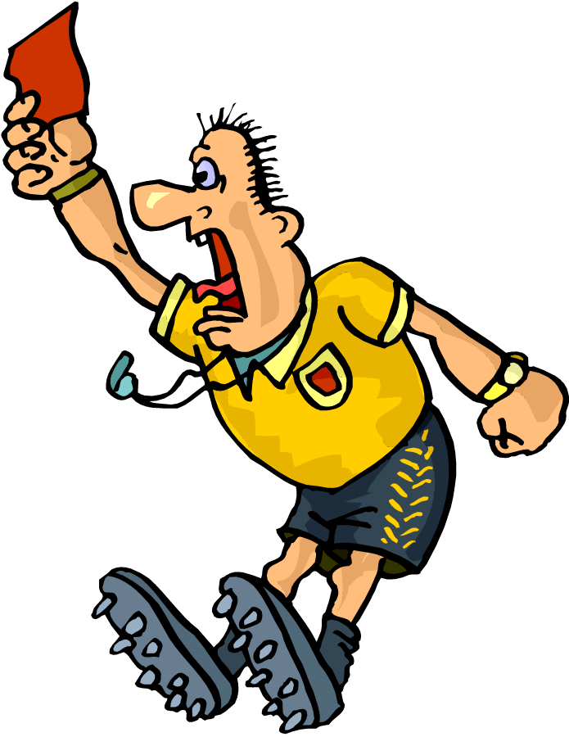
unfair means?
- not fair
Copyright © 2011 Kelly Mott

Slide 18

unlikely means?
- not likely
Copyright © 2011 Kelly Mott

Slide 19
Let’s look at the prefix:
dis-
Copyright © 2011 Kelly Mott

Slide 20
The prefix dis- means not.
Copyright © 2011 Kelly Mott

Slide 21
EXAMPLE WORDS
Copyright © 2011 Kelly Mott

Slide 22
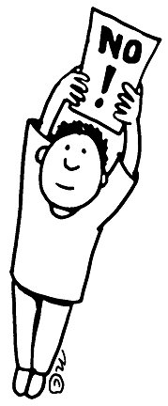
disapprove means?
- to not approve
Copyright © 2011 Kelly Mott

Slide 23

distrust means?
- to not trust
Copyright © 2011 Kelly Mott

Slide 24
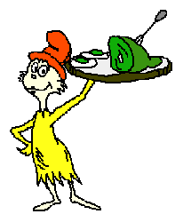
dislike means?
- to not like
Copyright © 2011 Kelly Mott

Slide 26
Part 2: Projectables
Copyright © 2011 Kelly Mott
Notes:
26

Slide 27

Projectable 1.5
Copyright © 2011 Kelly Mott

Slide 28
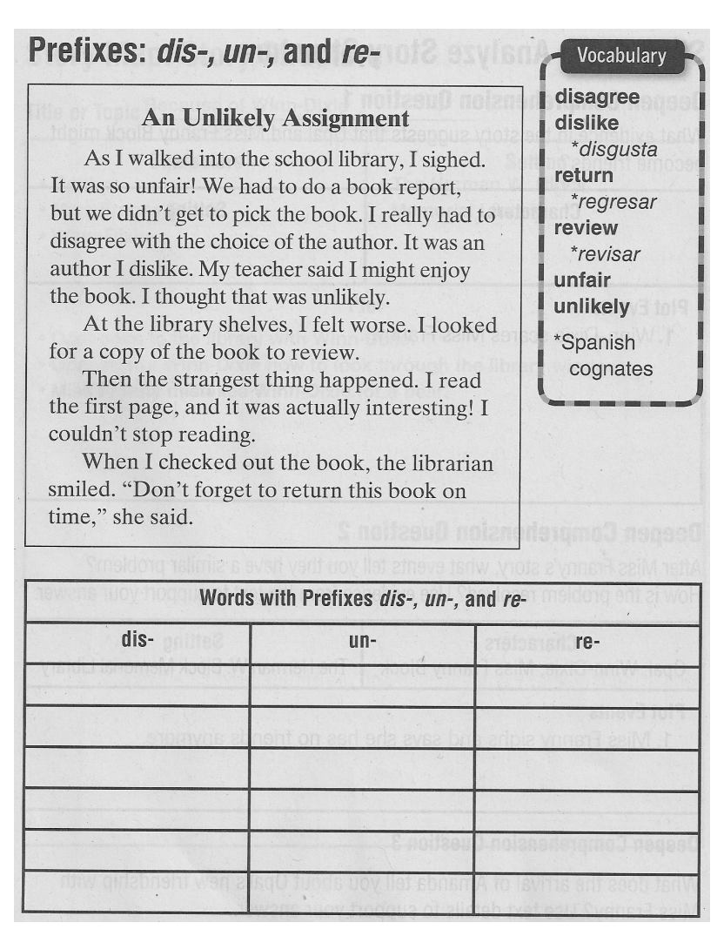

Slide 30
Part 3: Guided Practice
Copyright © 2011 Kelly Mott
Notes:
30

Slide 31
Turn your Practice Book to page 3.
Copyright © 2011 Kelly Mott

Slide 32
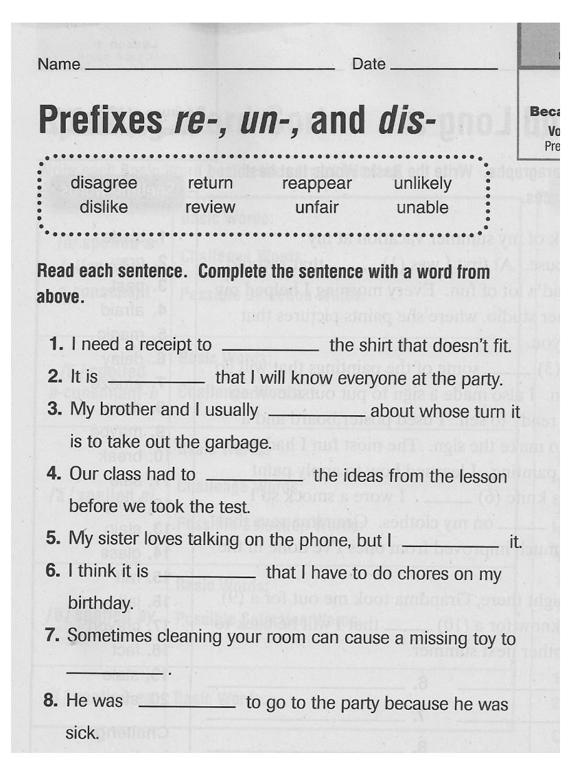

Slide 34
Part 4: Independent Practice
Copyright © 2011 Kelly Mott
Notes:
34

Slide 35
See Handout; page 19 in Grab and Go
Copyright © 2011 Kelly Mott

Slide 36
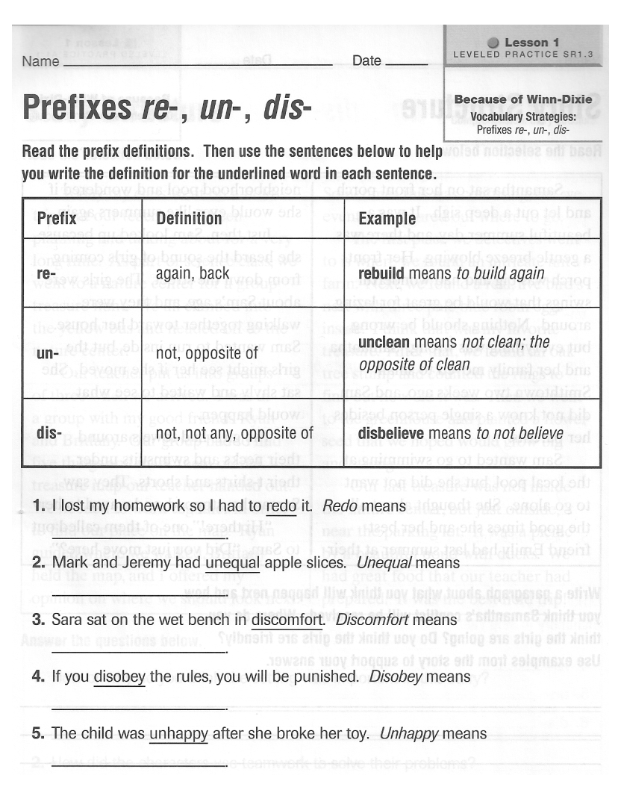

Slide 38
See Handout; page 25 in Grab and Go
Copyright © 2011 Kelly Mott

Slide 39
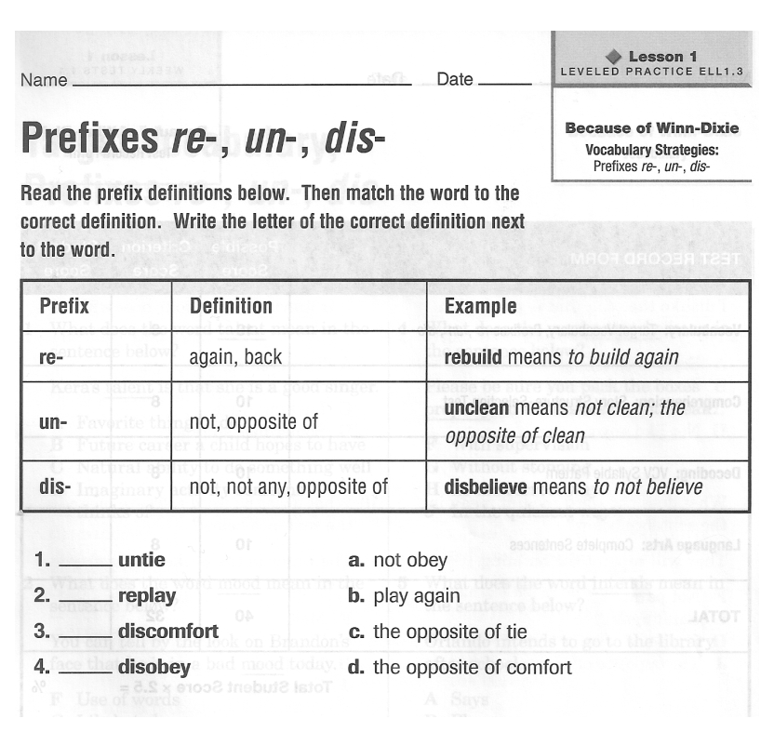

Slide 41

How did you do?
Copyright © 2011 Kelly Mott

Slide 42
Copyright © 2011 Kelly Mott

Slide 43


